Slide 1
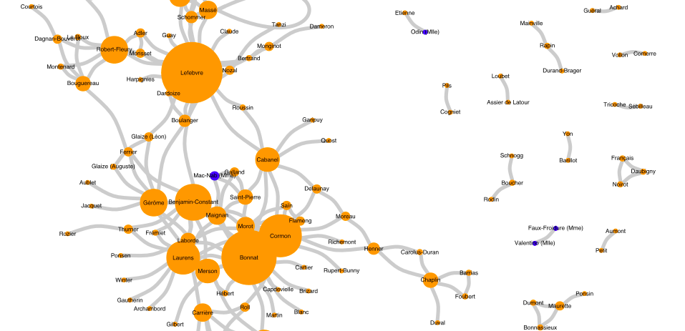
Network Analysis
with R (and beyond!)
NA+DAH, April 14, 2021
A Getty Advanced Workshop on
Network Analysis and Digital Art History
Léa Saint-Raymond (ENS-PSL)

Slide 2

What do you want to do ?
Compute statistics
Go fast
Draw beautiful networks (for publication)
Overlay a network on a map

Slide 3
What do you want to do ?
Compute statistics
Go fast
Use R
Draw beautiful networks (for publication)
(it depends on the map!)
Overlay a network on a map

Slide 4
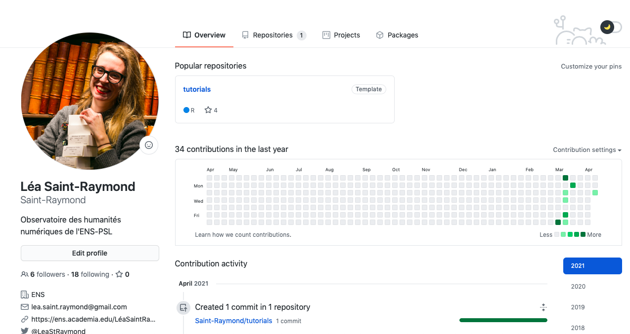
Clone the « tutorials » repository of my GitHub

Slide 5
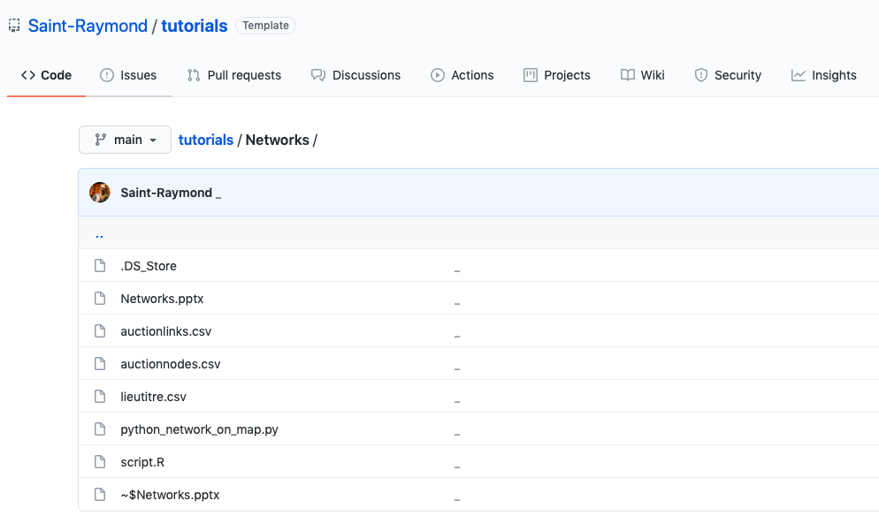
Download R, Rstudio and open the script.R file

Slide 6
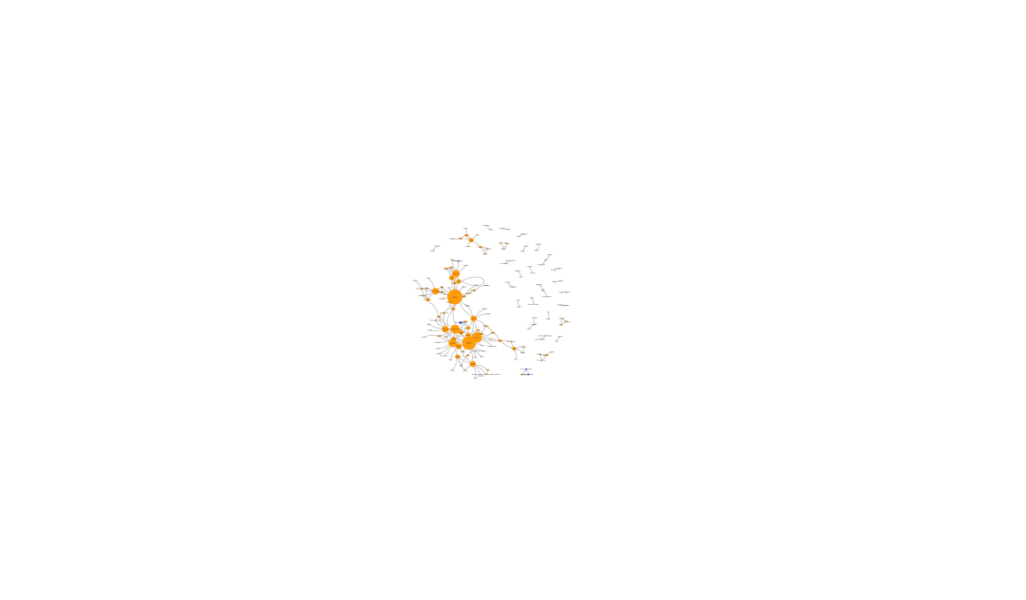
The output is quite tiny and ugly.
Save it as a svg file…

Slide 7
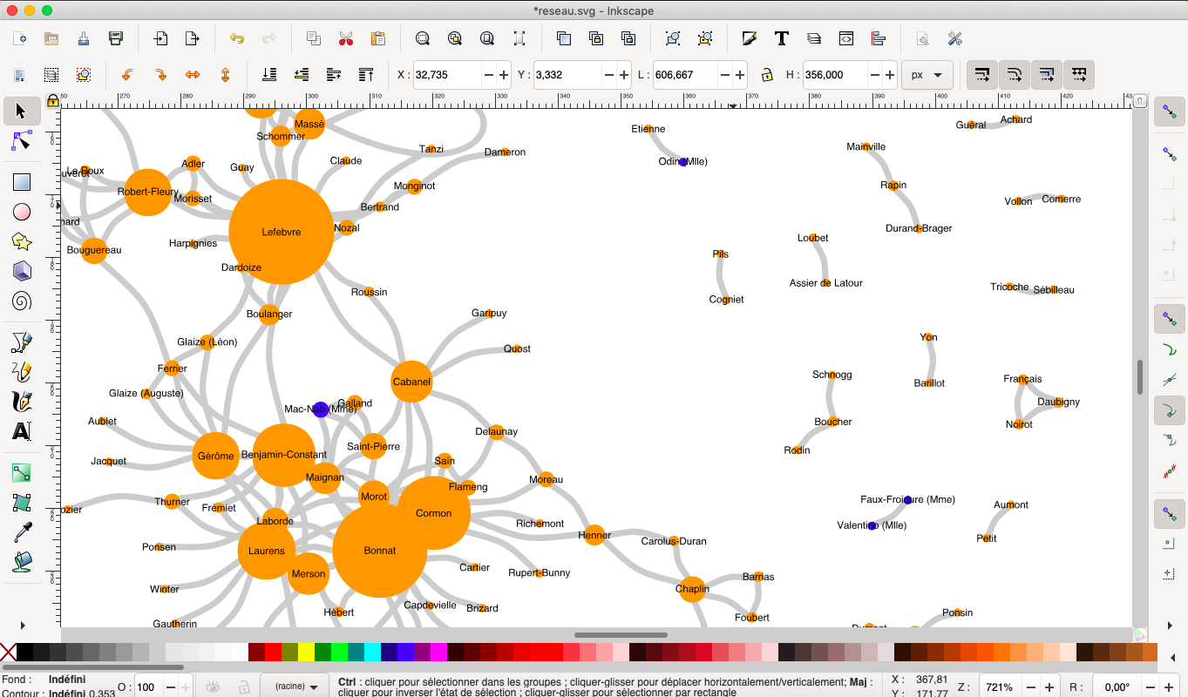
… and work on it with Inkscape.

Slide 8
What do you want to do ?
Compute statistics
Go fast
Use
Gephi
Draw beautiful networks (for publication)
Overlay a network on a map

Slide 9
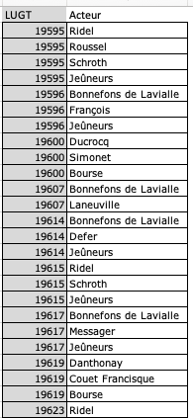
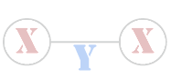
Option #1 : normal network.
I want a single type of nodes, for instance art market actors. They will be linked when they share a value in another column, for instance Lugt number.

Slide 10
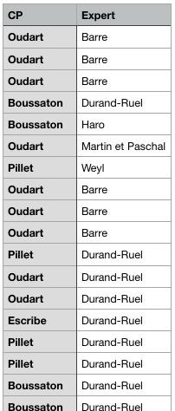

Option #2 : bipartite network.
I want two types of nodes, for instance auctioneers (CP) and experts. So column1 = CP and column 2 = experts.
Experts and CP will be linked if they appear in the same row of the table

Slide 11
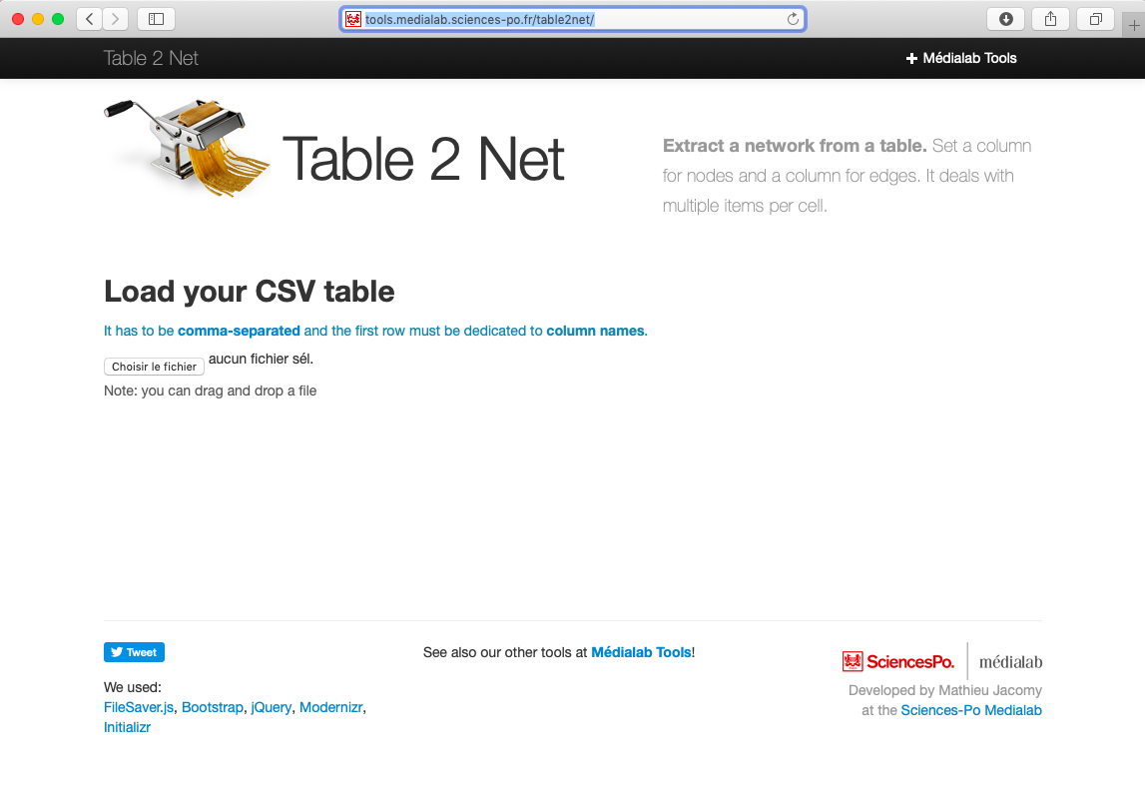
Prepare your input file with https://medialab.github.io/table2net/

Slide 12
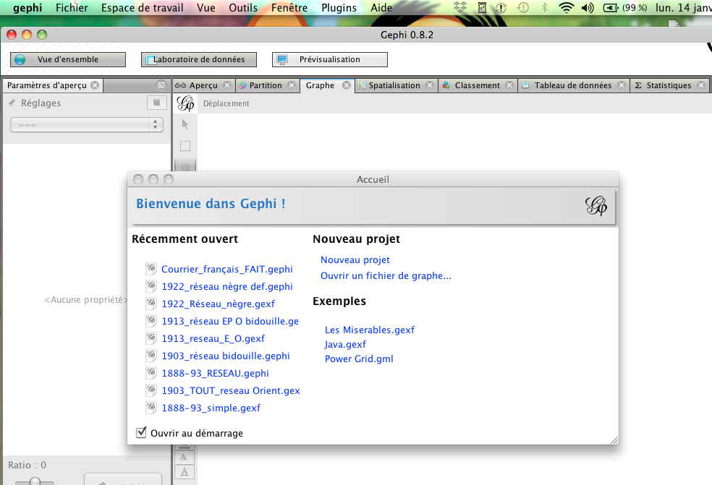
Open the gexf file

Slide 13
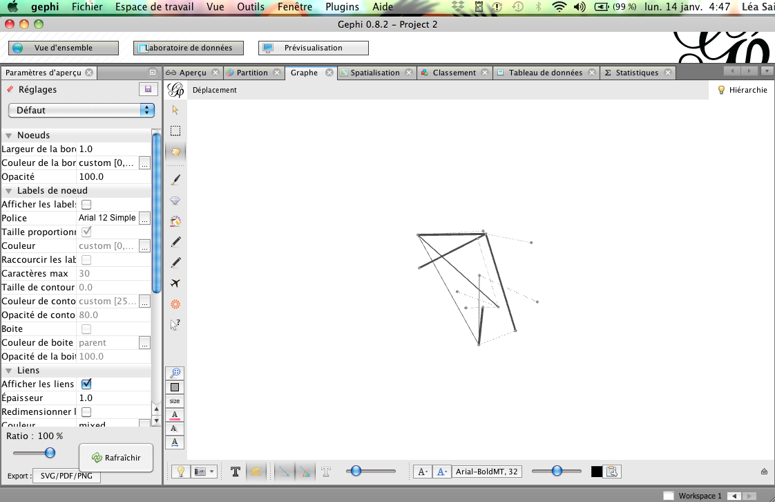
The « Vue d’ensemble » window allows to modify the shape of the network.

Slide 14
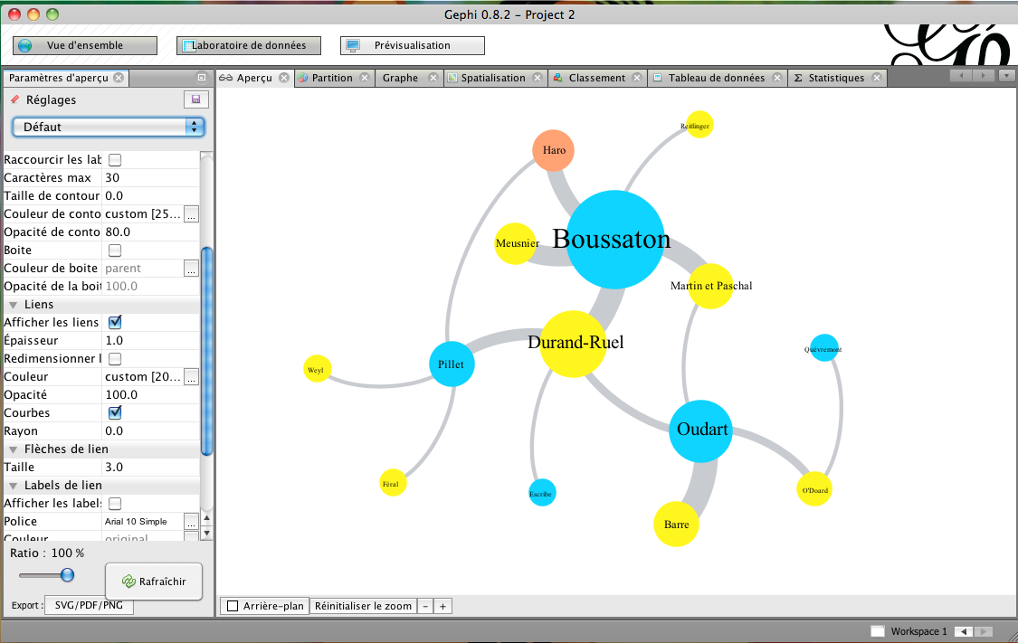
The « prévisualisation » window allows to improve the network.

Slide 15
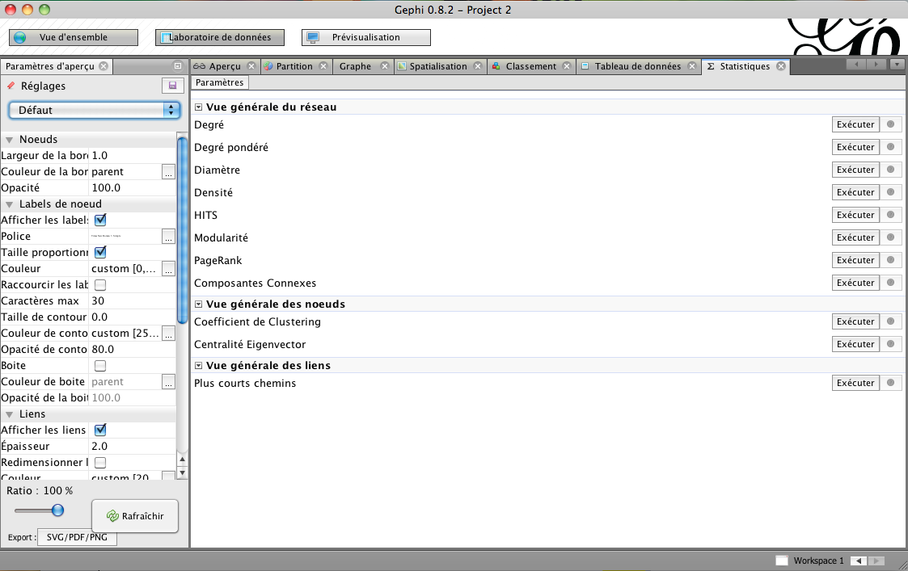
The « statistiques » window allows to compute the statistics of the network

Slide 16
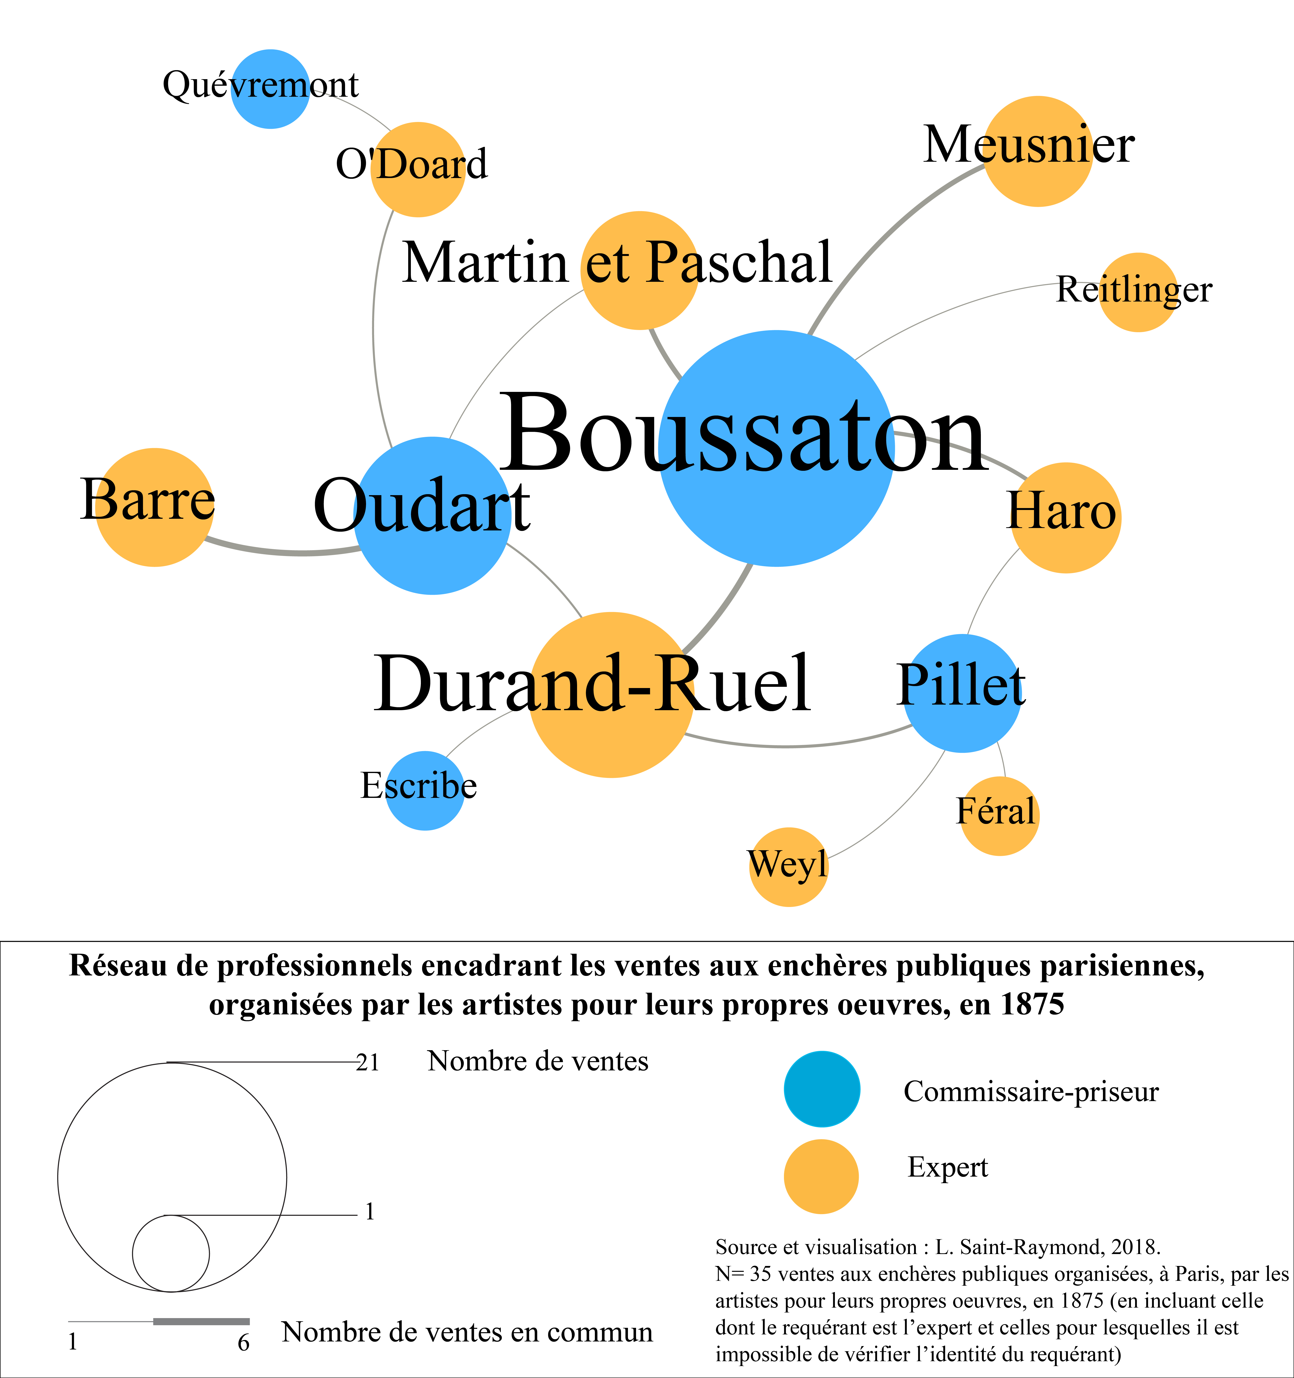
Export as a svg file and add the legend with Inkscape

Slide 17
What do you want to do ?
Compute statistics
Go fast
Use
Python
Draw beautiful networks (for publication)
Overlay a network on a map

Slide 18
Download Python and open the .py file

Slide 19
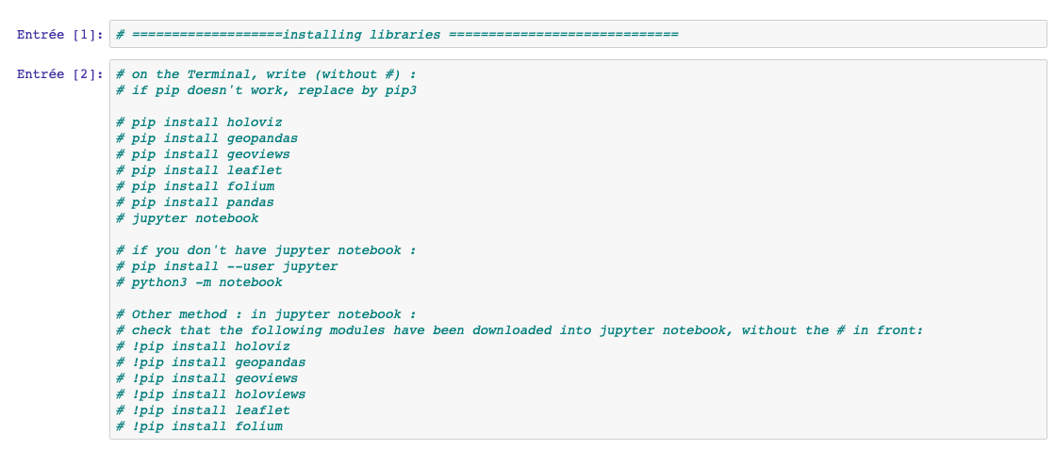

Slide 20
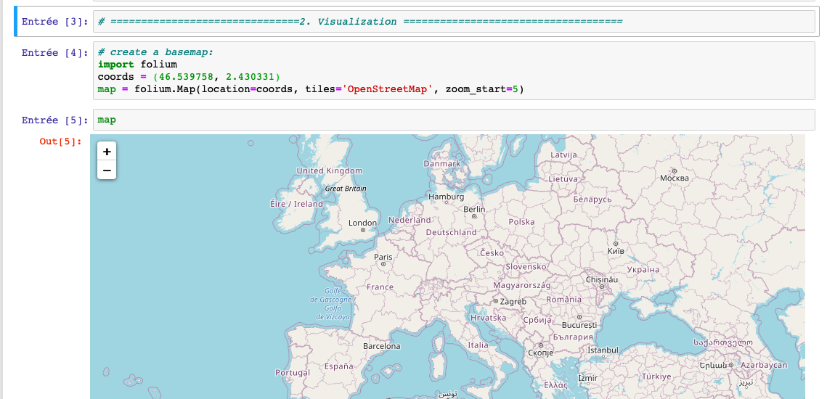

Slide 21
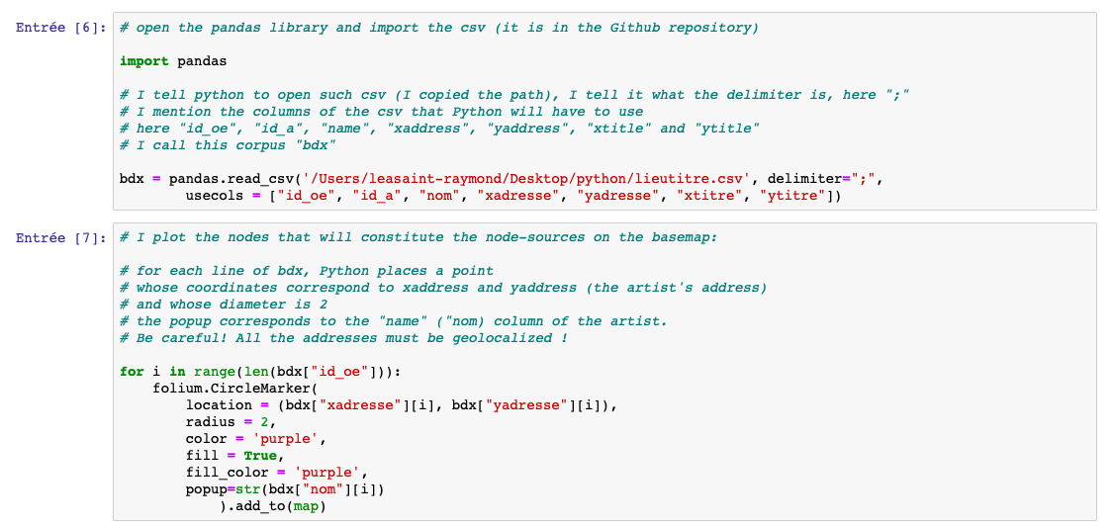

Slide 22
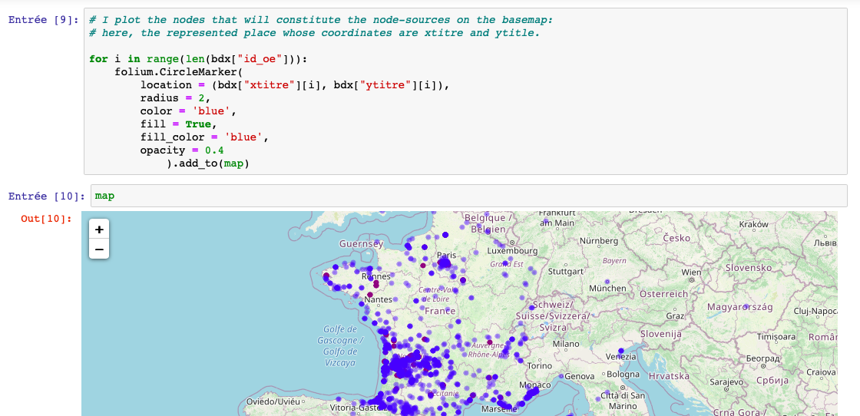

Slide 23
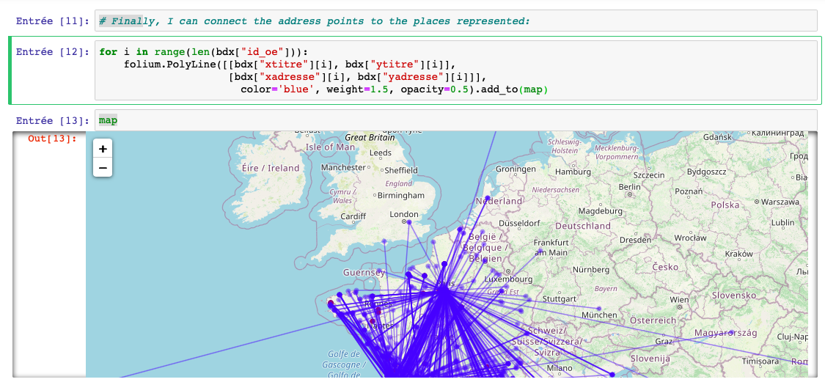

Slide 24
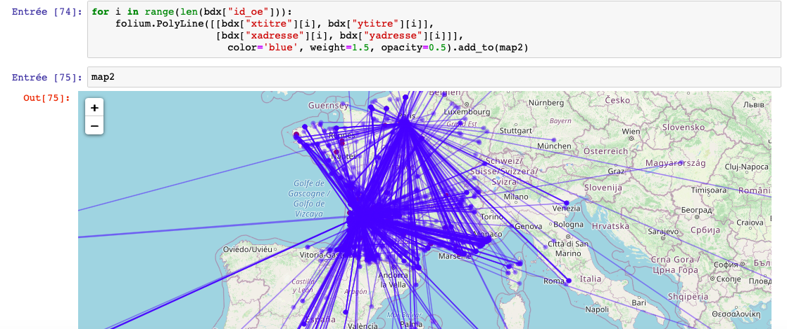
Conclusion: The best is the enemy of the good.
Network visualization is always a trade-off
between comprehensiveness and readability.

Slide 25
A last tip:
phylogenetic networks

Slide 26
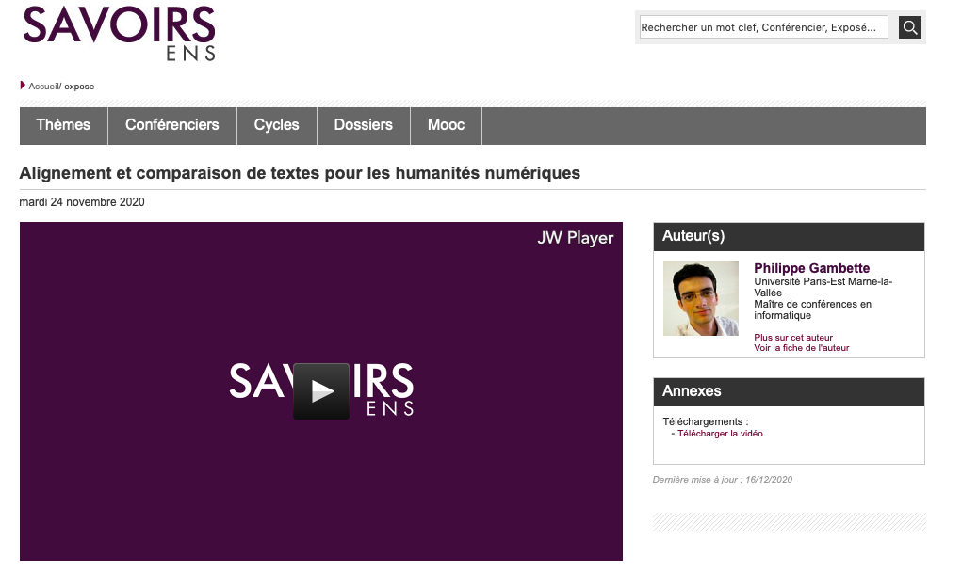
See Philippe Gambette’s conference at the DHAI seminar:
https://savoirs.ens.fr/expose.php?id=3912
Notes:
L

Slide 27
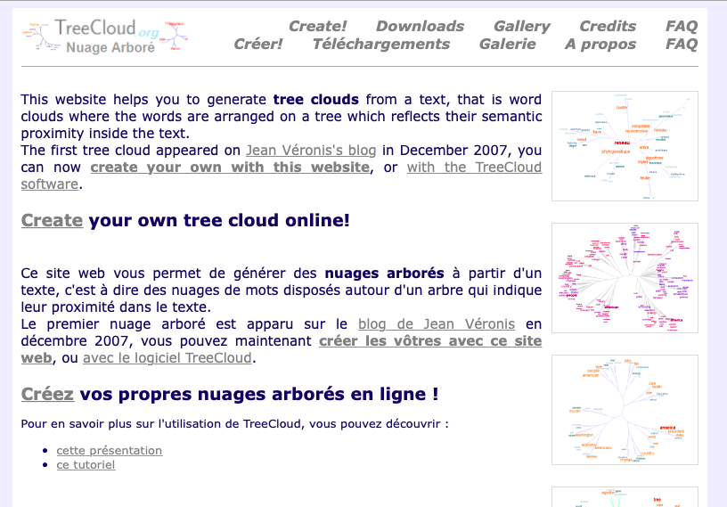
http://treecloud.univ-mlv.fr
Notes:
L

Slide 28
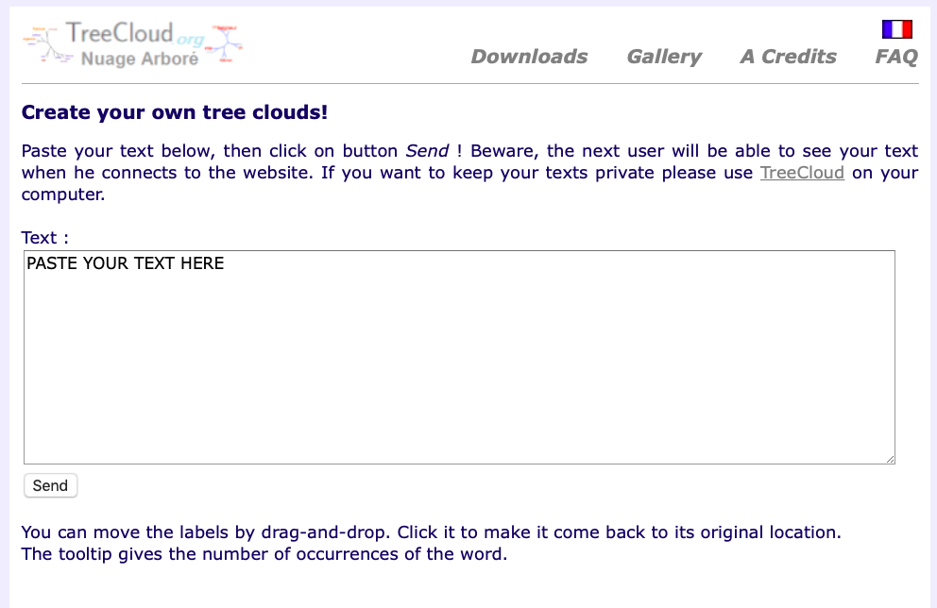
Notes:
L

Slide 29
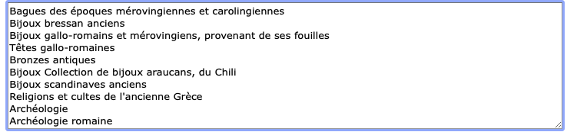
Notes:
L

Slide 30
